Slide 1
Resume Screening using k-Nearest Classifier
-Pradnya R Sangoram

Slide 2
Introduction:
Hiring the right talent is a challenge for all businesses. This challenge is magnified by the high volume of applicants if the business is labor-intensive, growing, and facing high attrition rates. Typically, large companies do not have enough time to open each CV, so they use machine learning algorithms for the Resume Screening task.

Slide 3
Outcome expectations:
The main expectation of this project will be classifying the resumes based on similarities and how closely they are connected and categorize into same groups of categories. And visualize the data and analyze it and take hiring decisions.

Slide 4
Steps:
Data cleaning and Convert the key words into categorical values
Model Training: (KNeighborsClassifier)
Data visualization and Results

Slide 5
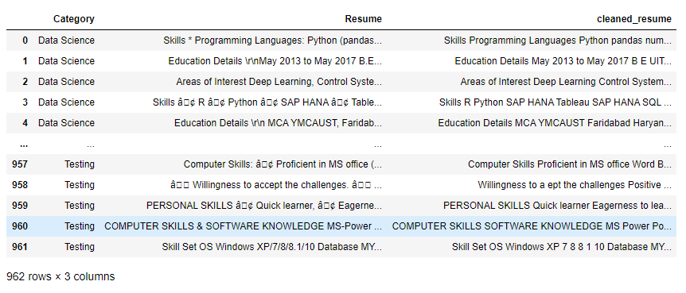
Removing URLs, Hashtags, Special Letters and punctuation:

Slide 6

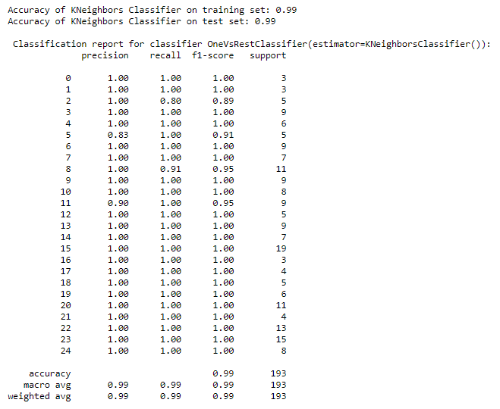



Model training: k-Nearest Classifier
Accuracy: 0.99 (Both on training and testing dataset)

Slide 7

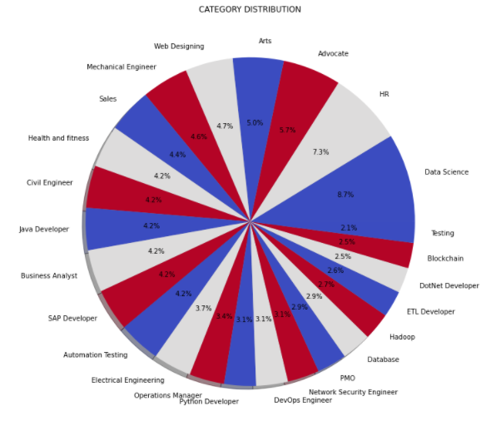
Visualization:

Slide 8
Thank You

